Slide 1
MXCuBE site report
Australian Synchrotron - ANSTO
MXCuBE/ISPyB meeting, 28-30 May 2024

Slide 2
 | Full beam size (µm)​ | Min beam size (µm)​ | Full beam flux at sample (ph/s)​ | Key Capabilities​
MX1​ | 180 x 150​ | 50 x 50​ | 3.40E+11​ | Stability Mini-kappa Low energy MAD/SAD​ Laser
MX2​ | 22 x 12​ | 10 x 8​ | 2.40E+12​ | Hotter beam Micro-collimators MAD/SAD​
MX3 | 14 x 2​ (15 x 15 defocussed) | 2 x 2​ | >6E+13​ | Microfocus Hotter beam Changeable beam size Serial crystallography Time-resolved crystallography In situ screening and collection Automated collection​

Slide 3
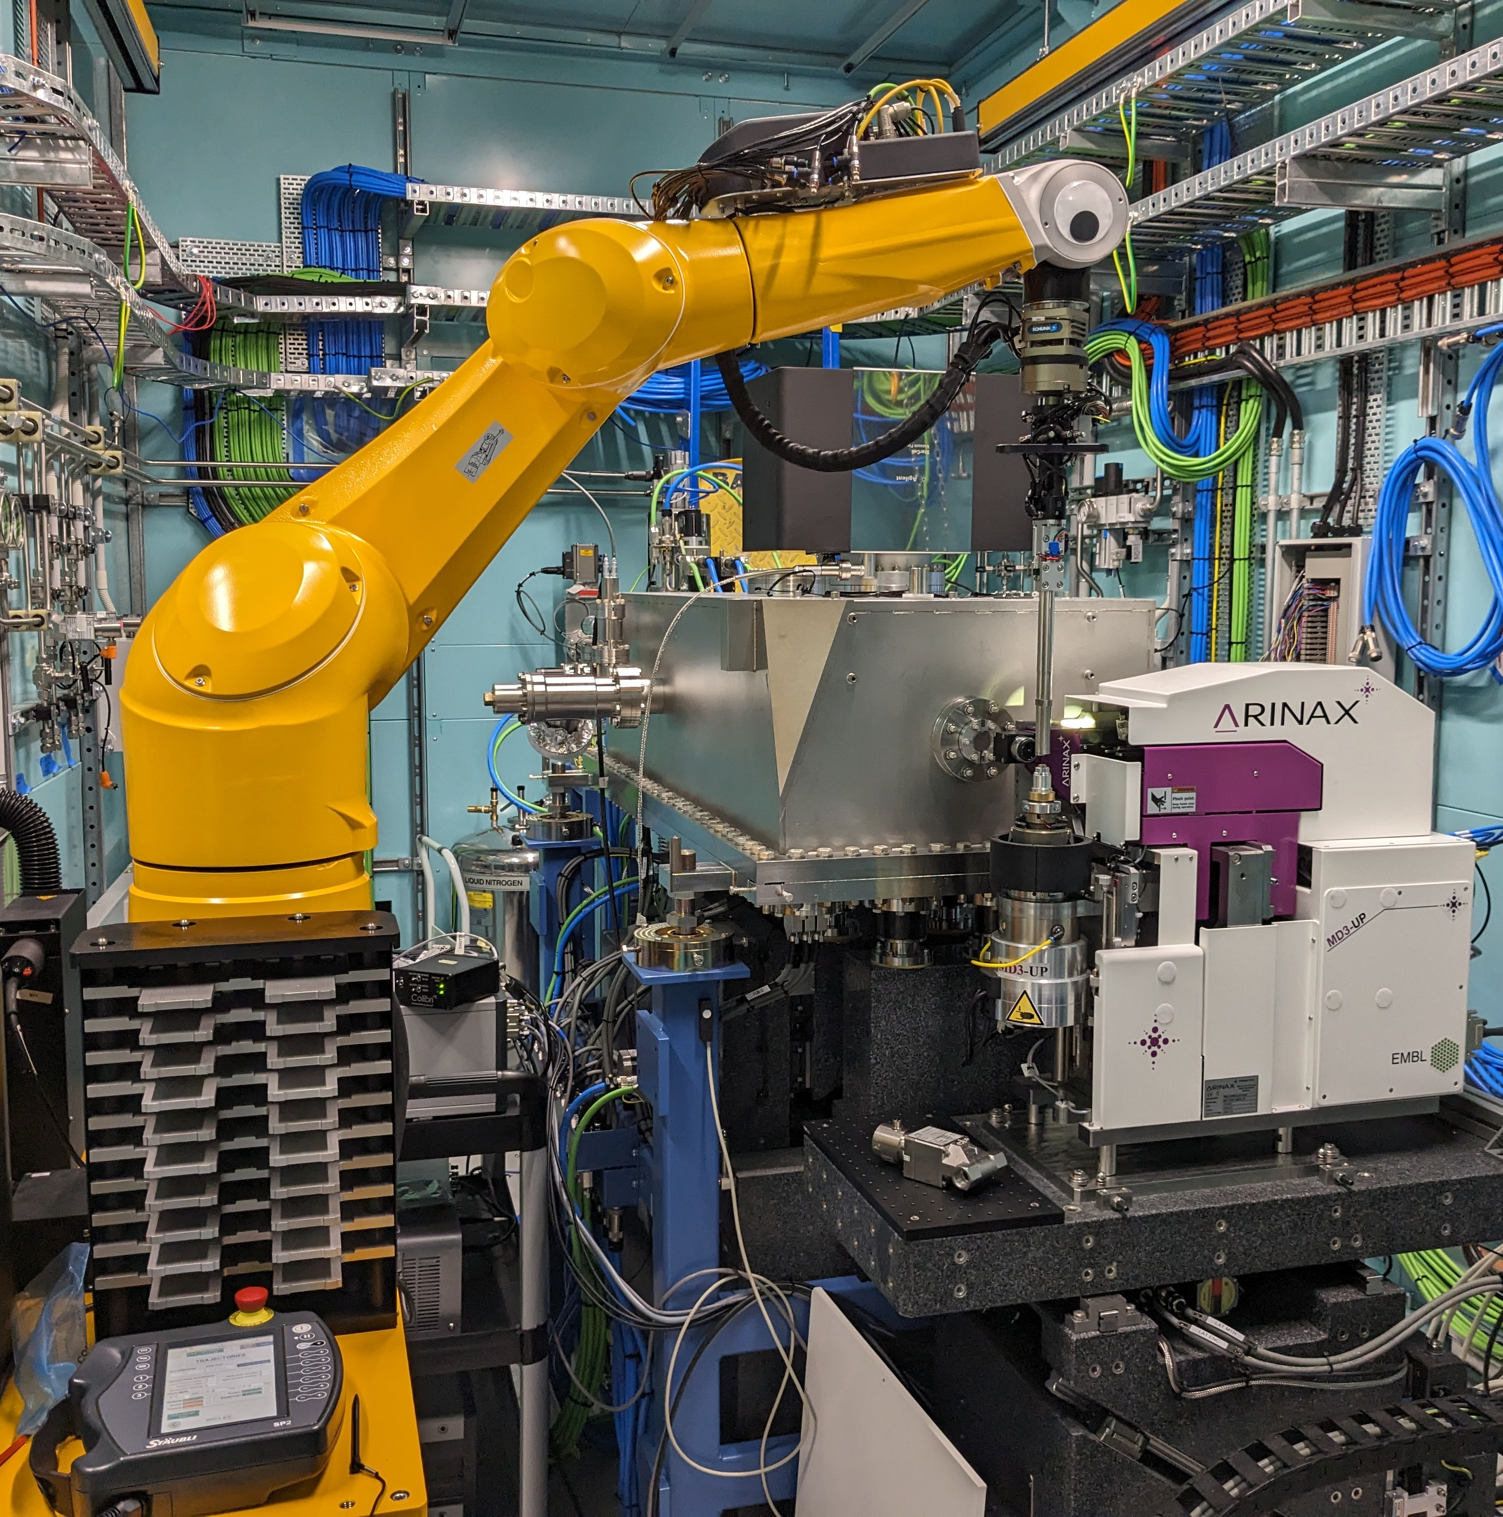
MX3 tech stack snippet
EPICS controls layer with Ophyd/Bluesky on top
MD3 up goni with Isara robot
Eiger2X 16M detector
MXCuBE UI with own non-ISPyB backend
PostgreSQL/SQLAlchemy/FastAPI/Pydantic mashup
Prefect for workflow orchestration

Slide 4
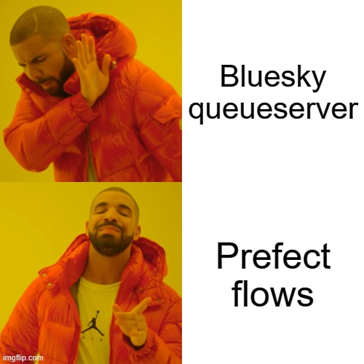
Prefect as a replacement of the Bluesky-queueserver
Motivation
Bluesky plans can be executed directly through Prefect, bypassing the need for the Bluesky queueserver
First implementation was successfully completed by BioSAXS

Slide 5
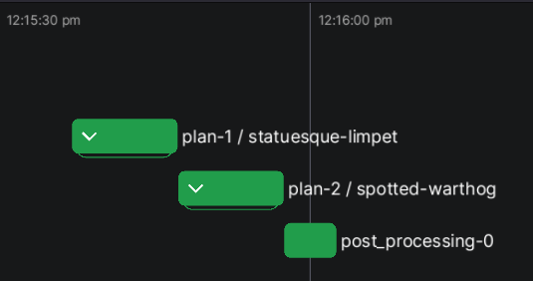
Implementation
Bluesky plans are executed as prefect flows using a local Run Engine
Plans are queued by a parent prefect flow
The state of all flows can be easily tracked using the Prefect client

Slide 6
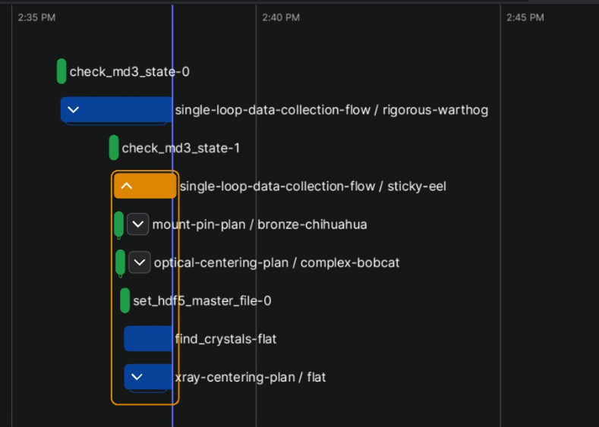
Prefect as a replacement of the Bluesky-queueserver
Advantages
Visualisation of flows via the Prefect UI
Fewer services to be maintained
Easier debugging

Slide 7
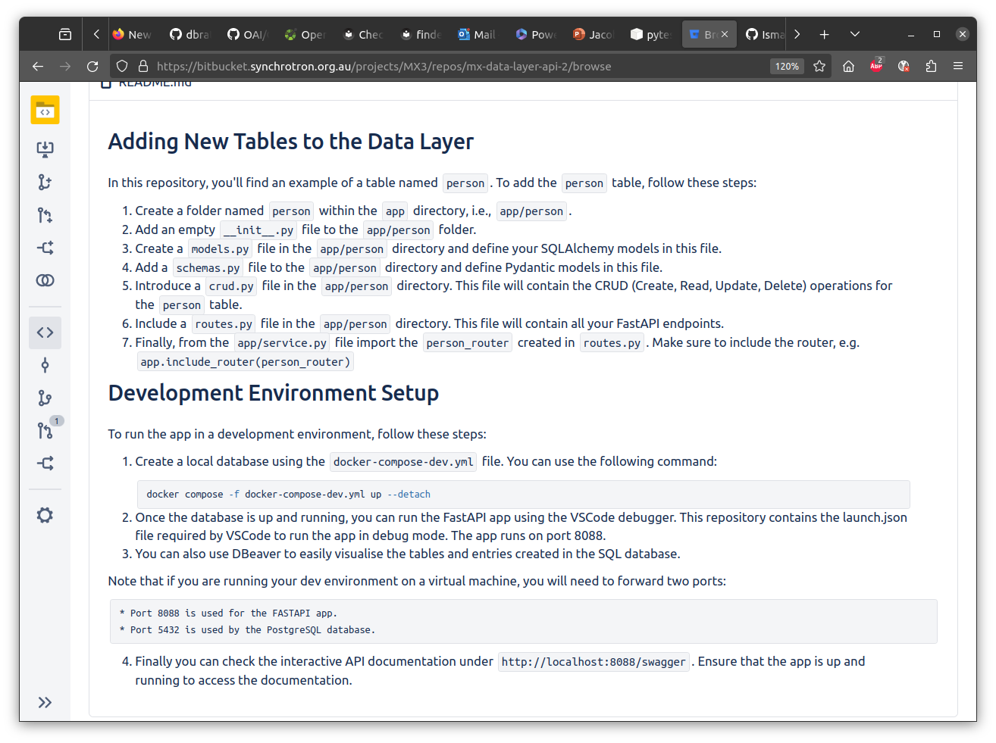
PostgreSQL – Hybrid Dependency Mocking
Context:
With the database schema growing rapidly, it soon became clear that manual testing was no longer sufficient, common code mistakes could be missed in PRs.
Automated testing was required, needing to cover both Python and database layers, test cases needed to be maintainable by non-devs.

Slide 8
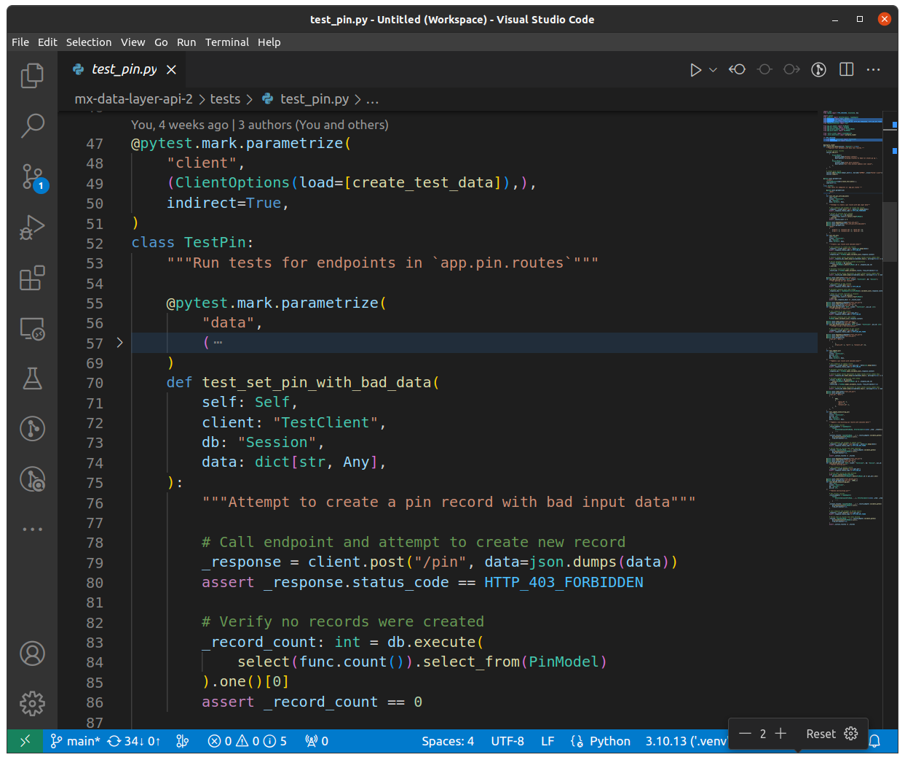
PostgreSQL – Hybrid Dependency Mocking
Solution:
Testing Framework
Pytest - With plugins "pytest-cov", "pytest-html", "pytest-mock", "pytest-postgresql", and "pytest-dependency".
Testing Methodology
We use Class-based testing, meaning one class, contains all test-cases for one database table.
Parameterization, to re-run tests, varying the input data.
Class-scoped fixtures are used to manage test databases and patch code to use the test database.

Slide 9

Cybersecurity Update
Since the question of how best to manage Cybersecurity risks around the deployment of MXCuBE-Web was raised, we've had multiple discussions internally, regarding best practices, mitigation techniques and what support can be made available.

Slide 10
Cybersecurity Update
Best Practices
Minimum Access Policy
Restricting users to the least amount of access to privileged resources and permissions that are needed to run an experiment.
Application Firewall
The application by default, will be firewalled from all network resources, exceptions will be granted as and when needed.
Mitigation Techniques
Single SignOn
MX3 will be using existing internal Single-SignOn infrastructure.
Security Review
MX3 will be making an external remote access program available for beamline users. Before going live, our infrastructure and deployment configuration will be subjected to an ANSTO cybersecurity review and likely penetration testing.

Slide 11
Plans for the next six months
Hot commissioning
Expert user feedback
Month 1-3 MXCuBE-Core and -Web locked at v1.79.0 and 4.34.0
Month 4-6 catch up with current main
‘Finalize’ database schema and add to MXLIMS repo

Slide 12
MX3 Project
Scientists
Tom Caradoc-Davies
Daniel Eriksson
Eleanor Campbell
Suk-Youl Park*
Scientific Computing Francisco Hernandez Vivanco
Jacob Oldfield
Rakesh Khemaram
Lead Engineer
Hima Cherukuvada
Mechanical Technician
Joe Quinton
Project Manager
Nicole Cain
Controls Engineer
Simin Chen
PLC lead
Graham Barrow
Beamline Advisory Panel
Charlie Bond (Chair) – UWA
Peter Czabotar – WEHI
Chris Sumby - UA
Stephanie Gras – MU
MX1 & MX2
Rachel Williamson
Alan Riboldi-Tunnicliffe
Santosh Panjikar
Stephen Harrop
Stephanie Boer
Yogesh Khandokar
Rosie Young
Chris Szeto
Gwyndaf Evans – DLS, UK
Aina Cohen - SLAC, USA
Emily Parker - VUW, NZ
Notes:
Busy slide – busy people!

Slide 13
Thank You

